Slide 1
Unsupervised Learning

Slide 2
Machine Learning (Clustering)
Clustering is primarily an exploratory technique to discover hidden structures of the data, possibly as a prelude to more focused analysis or decision processes
A way to decompose a data set into subsets with each subset representing a group with similar characteristics
Group such that objects in the same group are more similar to each other in some sense than to objects of different groups
The groups are known as clusters and each cluster gets distinct label called cluster id, the centroid of the cluster, and other details
Clustering is often used as a lead-in to classification. Once the clusters are identified, labels can be applied to each cluster to classify each group based on its characteristics

Slide 3
Applications of clustering
Some specific applications of k-means are image processing, medical, and customer segmentation
Image processing : used to cluster of pixels representing objects in each frame. The attributes of each pixel can include brightness, color, and location, the x and y coordinates in the frame. Successive frames are examined to identify any changes to the clusters. These newly identified clusters may indicate unauthorized access to a facility.
Medical : Patient attributes such as age, height, weight, systolic and diastolic blood pressures, cholesterol level, and other attributes can identify naturally occurring clusters under various health conditions
Customer segmentation : Cluster customers on basis of frequency of purchase, recency of purchase, value of purchase and look for common attributes among high value customers. Target all potential customers who have similar attributes

Slide 4
Clustering types
Two broad categories of clustering include hierarchical (agglomerative, divisive) and non hierarchical
Hierarchical clustering
Agglomerative clustering algorithm uses a bottom-up approach and merges smaller clusters into larger ones
Divisive clustering uses top-bottom approach to break a large cluster into smaller clusters
Non-hierarchical / partitional clusters are formed on assumption that the clusters are disjoint and there is no hierarchical relation between them. K Means is an example

Slide 5
Machine Learning (Clustering – Distance calculations)
Irrespective of the clustering algorithm, we need a way of defining and calculating distance between two data points in mathematical space (records in the database)
We also need a way to define and calculate distance between clusters
Distance between two data points is a measure of similarity between the points
The lesser the distance, more similar the data points are
There are many ways of calculating distance between two points i.e. if d = f(x,y) then there are many ways in which f can be implemented
Notes:
The 4 properties that a function must have in order to be a distance function:
D(x, y) = 0 if and only if x = y
D(x, y) = D(y, x)
D(x, y) >= 0
D(x, z) <= D(x, y) + D(y, z)
Following is an example of a distance function where the triangle inequality is a strict inequality when the 3 points are distinct.
Let D(x, y) = 0 if x = y and 1 otherwise.
Verification that this function has the 4 required properties is straightforward, property 1, 2 and 3 follow directly from the definition. For property 4, we distinguish distinct cases:
x = z, but x <> y and y <> z. We find: D(x, z) = 0, D(x, y) + D(y, z) = 2, OK.
x <> z, x = y, y <> z. D(x, z) = 1, D(x, y) + D(y, z) = 1, OK.
x <> z, x <> y, y = z. D(x, z) = 1, D(x, y) + D(y, z) = 1, OK.
x <> z, x <> y, y <> z. D(x, z) = 1, D(x, y) + D(x, z) = 2, OK.
For your requirements, the 4th point of the above applies. We see that the strict inequality clearly holds.
The name of this distance function is the "discrete metric", with metric being the term commonly used instead of distance function.
Source: https://www.reddit.com/r/askscience/comments/40i2ju/can_there_be_such_a_distance_function/

Slide 6
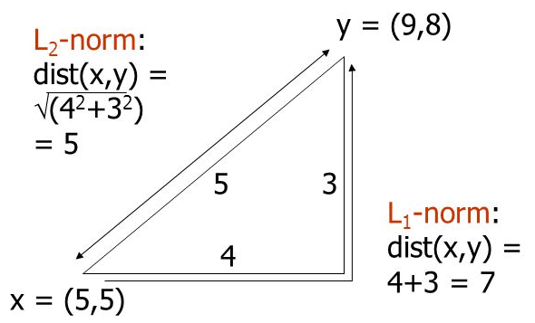
Machine Learning (Clustering – Distance calculations)
Euclidean Distance
L2 norm : d(x,y) = square root of the sum of the squares of the differences between x and y in each dimension. The most common notion of “distance”. If there are two dimensions x and y, the distance between two point A and B is –
L1 norm : sum of the differences in each dimension. Manhattan distance = distance if you had to travel along coordinates only

Slide 7
Machine Learning (Clustering – Distance calculations)
Non Euclidean Distance
Jaccard distance for sets = 1 minus ratio of sizes of intersection and union.
Cosine distance = angle between vectors from the origin to the points in question.
Edit distance = number of inserts and deletes to change one string into another
Mahalanobis distance
Normalizing the numerical measurements
The measures computed in Euclidian methods are highly influenced by the scale of each variable
Variables with larger scale have much greater influence over the total distance
Hence all the measurements are converted to same scale (convert to z scores for e.g.)
Note: distance measurement is just a way of assessing similarity/ dissimilarity. The common parlance of distance will not help in understanding other methods of distance calculations

Slide 8
Machine Learning (Clustering – Distance calculations)
Distance measures and some key points:
Choice of distance measures play a key role in cluster analysis.
Knowledge of the distribution of data (gaussian or otherwise) will help
Are the various attributes independent or influence eachother
Are their outliers in the data on the various dimensions
Though Euclidian distance is the most commonly used distance metric, it has three main features that should be kept in view
It is highly scale dependent. Changing the units of one variable can have a huge influence on the results. Hence standardizing the dimensions is a good practice
It completely ignores the relationship between measurements (Refer to Mahalanobis distance diagram)
It is sensitive to outliers. If the data has outliers that cannot be handled or removed, use of Manhattan distance is preferred

Slide 9
Machine Learning (K Means Clustering – Some considerations )
K-Means (a.k.a Lloyd’s algorithm) clusters data by separating data points into groups of equal variance, minimizing a criterion known as the inertia or within-cluster sum-of-squared errors
It requires the number of clusters to be specified, hence the term “K” in its name
It divides the samples into K disjoint clusters Ci, each described by the mean of the samples in the cluster. The means are commonly called “centroids” (they are not the points from the data)
The K-Means algorithm chooses centroids that minimizes the inertia across all the clusters

Slide 10
Machine Learning (K Means Clustering – Some considerations )
From a computational perspective, the k-means algorithm is indifferent to the units of measure for a given attribute (for example, meters or centimeters for a patient's height). However, the algorithm will identify different clusters depending on the choice of the units of measure.
Choosing different starting points can result in different clusters. The algorithm is sensitive to the initial starting condition
Given enough time, K-means will always converge, however this may be a local minimum. This is highly dependent on the initialization of the centroids
Scikit-learn has implemented K-mean++ initialization scheme, which initializes centroids to be distant to one another which provably leads to better results

Slide 11
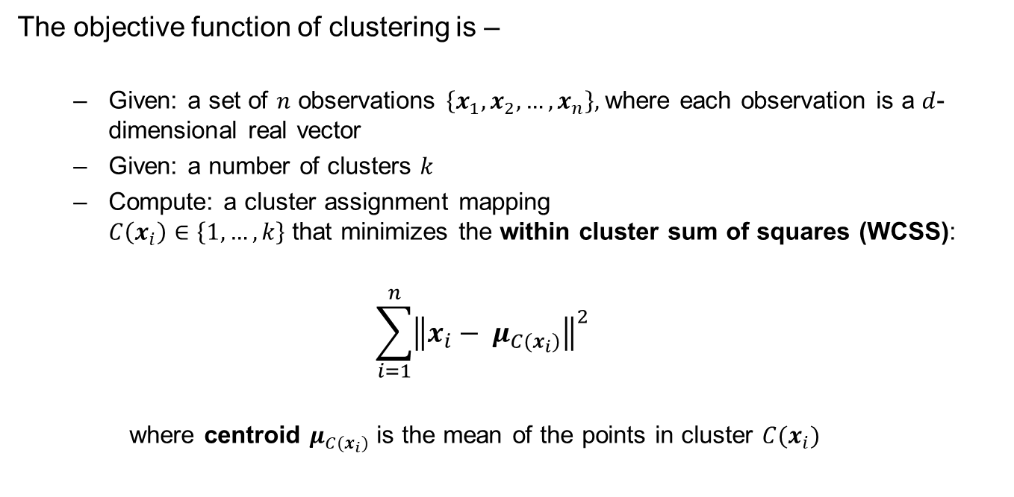
Machine Learning (K-means Clustering)
The objective function of clustering is –
Given: a set of $n$ observations $\left\{x_{1},x_{2}, …,x_{n}\right\},$where each observation is a $d$-dimensional real vector
Given: a number of clusters $k$
Compute: a cluster assignment mapping $C\left(x_{i}\right)∈\left\{1, …, k\right\}$ that minimizes the within cluster sum of squares (WCSS):
$$\sum_{i=1}^{n}{{\left\|x_{i}− μ_{C(x_{i})}\right\|}^{2}}$$
where centroid $μ_{C(x_{i})}$ is the mean of the points in cluster $C(x_{i})$

Slide 12
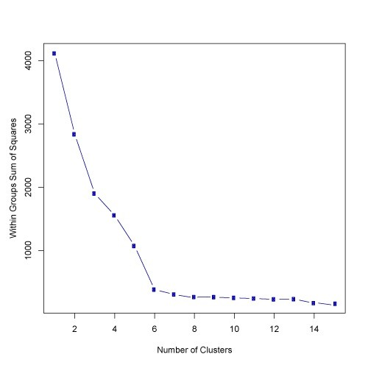
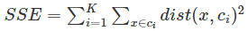
Machine Learning (K-means Clustering)
Without apriori knowledge, one can use elbow method that measures the homogeneity or heterogeneity within clusters as the number of clusters change (i.e. K is changed). One way to measure is use sum of square errors in each cluster

Slide 13
k-Means Clustering assumes real-valued data distributed in clusters that are:
Separate
Roughly hyperspherical (circular in 2D, spherical in 3D) or easily clustered via a Voronoi partition.
Similar size
Similar density
Even with these assumptions being met, k-Means Clustering is not guaranteed to find the global minimum

Slide 14
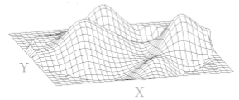
Visual Analysis for Clustering
Visual analysis of the attributes selected for the clustering may given an idea of the range of values that K should be evaluated in
Identifying the attributes on which clusters are clearly demarcated and using them in incremental order to build the multi-dimensional clusters likely to give much better clusters than using all the attributes at one go

Slide 15
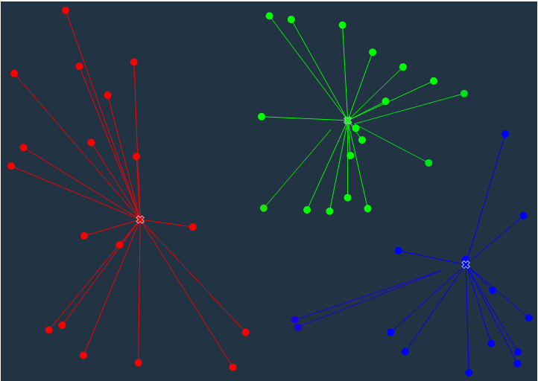
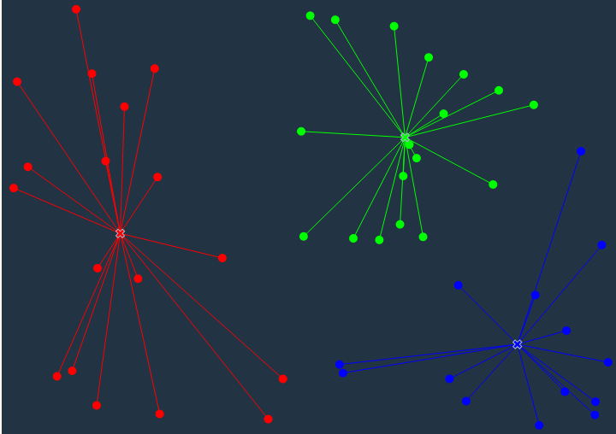
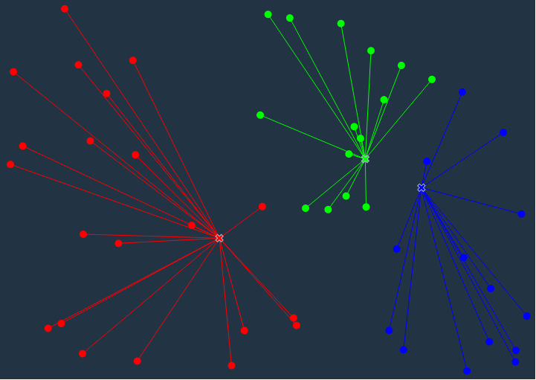
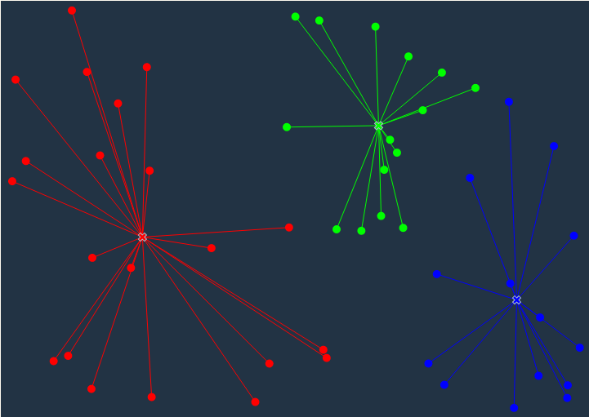
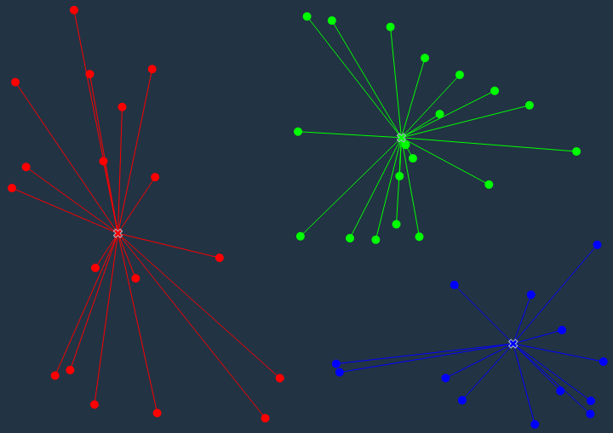
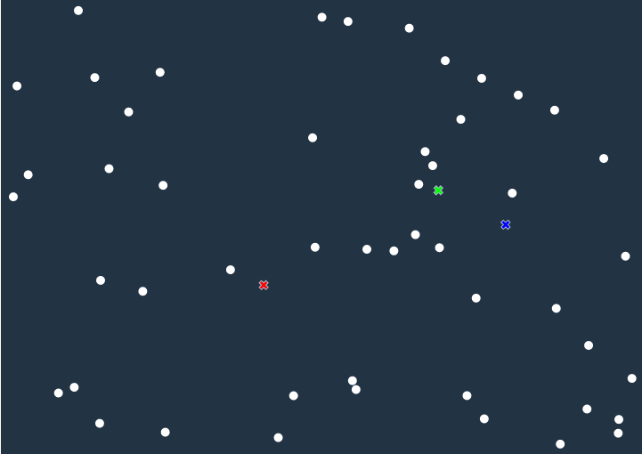
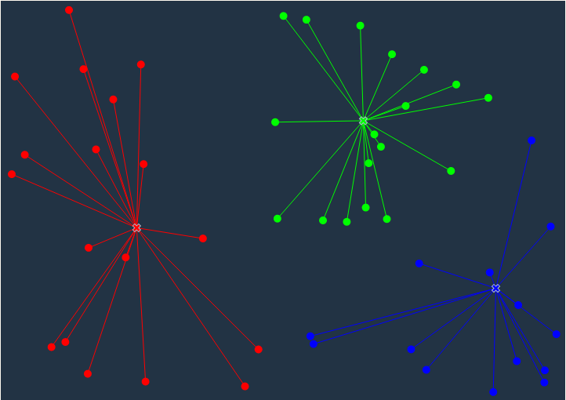
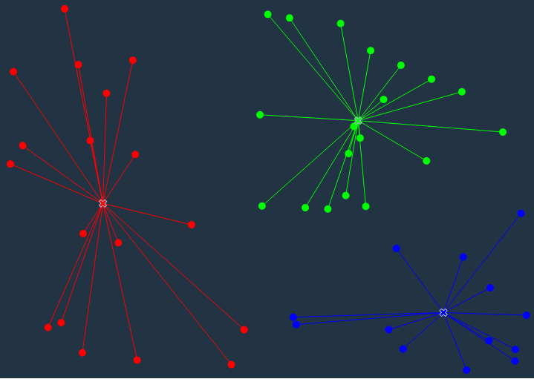
Machine Learning (K-means Clustering)
K-means treats feature values as coordinates in the multi-dimensional feature space
Calculate distance of the points from each of the three selected points. Link to the one closest
In the update phase the average position of each cluster is calculated (based on position of the points in the cluster)
Note : based on the distance of some boundary points from the new centroid, they get reallocated to different cluster
Since K = 3
Select 3 points at random from the data points
Ref: http://tech.nitoyon.com/en/blog/2013/11/07/k-means/

Slide 16
Dynamic Clustering
Clustering on correct attributes is the key to good clustering results.
We can also consider those attributes who's value changes with time. For e.g. age, income category, years of work experience etc.
We can use sequential k means clustering over time to track individual clusters (how they change in size, shape and position
We can also understand how individual data points move across clusters, form new clusters etc.
Analyzing the changes in the clusters over time using metrics such as
Cluster size, new entries and exits one can analyze the impact of strategies designed based on earlier clustering analysis

Slide 17
Machine Learning (K-Means Clustering)
Strengths | Weakness
Use simple principles without the need for any complex statistical terms | Computationally intensive How to fix K?
Once clusters and their associated centroids are identified, it is easy to assign new objects (for example, new customers) to a cluster based on the object's distance from the closest centroid | The k-means algorithm is sensitive to the starting positions of the initial centroid. Thus, it is important to rerun the k-means analysis several times for a particular value of k to ensure the cluster results provide the overall minimum WSS
Because the method is unsupervised, using k-means helps to eliminate subjectivity from the analysis. | Susceptible to curse of dimensionality Final clusters strongly depend on initial starting configurations

Slide 18
Machine Learning (K-means Clustering)
Lab- 1 Analyze auto mpg data set using K means to explore the data in terms of the various attributes
Sol: KMeansClustering_Auto_Mpg.ipynb

Slide 19
Machine Learning (Hierarchical (Agglomerative ) Clustering)
The agglomerative clustering starts with each cluster comprising exactly one data point in the feature space
It progressively agglomerates / combines the two nearest clusters until there is one grand cluster left in the feature space
For the closest cluster analysis, each of the inter cluster distance measurement techniques (single link, complete link, average link, centroid distance) can be implemented
In single linkage method, the minimum distance between nearest points from the two clusters is used to consolidate clusters
In complete linkage, distance between two farthest points form each cluster is considered
Group average clustering is based on the average distance between clusters
Prior domain knowledge helps in deciding the inter cluster distance metric selection. If the clusters are likely to be in long chain or sausage like, minimum distance (single linkage) would be a good choice
Complete and average linkage are better choice if the clusters are likely to be spherical

Slide 20
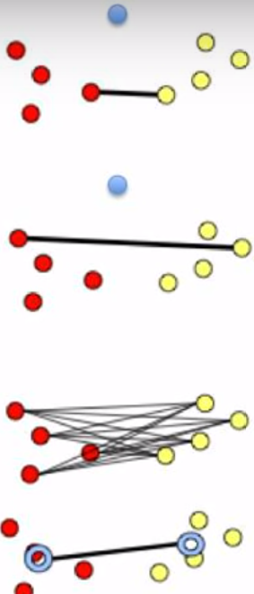
Machine Learning (Clustering – Measuring distance between clusters)
Ideally, a good clustering should result in compact clusters separated from one another by maximal distance. This calls for measuring the distance between cluster. The most widely used methods include :
Minimum distance(single linkage) – is the distance between pair of records Ai and Bj that belong to clusters A and B respectively and are closest
Maximum distance(complete linkage) – is the largest distance between the pair of records Ai and Bj that belong to cluster A and B respectively
Average distance (average linkage) - average distance of all possible distances between records in one cluster to records in other cluster
Centroid distance - the distance between centroids of the different clusters.
Distance between clusters is used in hierarchical clustering

Slide 21
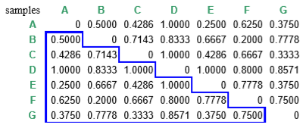
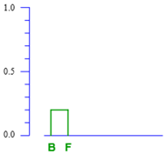
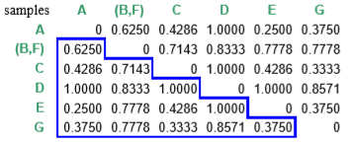
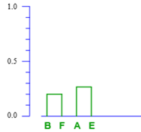
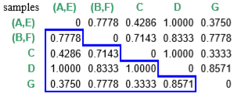
Complete Linkage

Slide 22
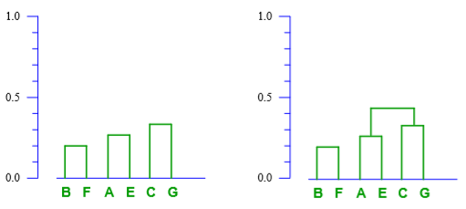
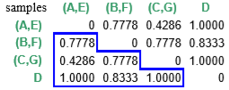

Slide 23
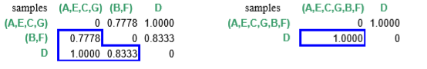
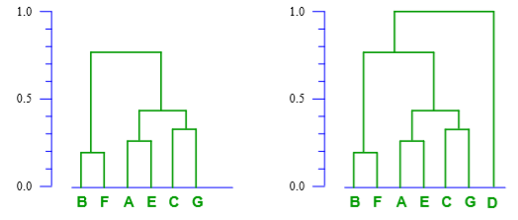

Slide 24
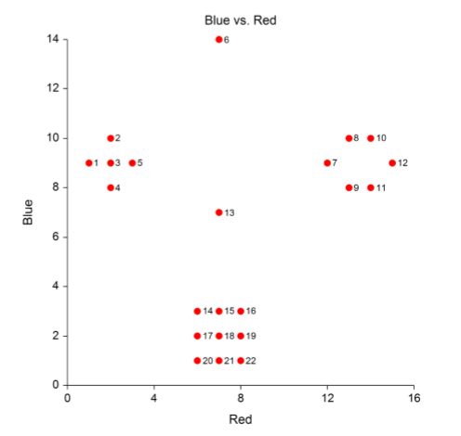
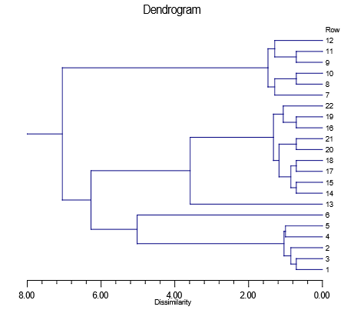
Machine Learning (Hierarchical (Agglomerative ) Clustering)
Dendrogram is a tree like diagram that summarizes the process of clustering. At the leaf are the records representing the data points
Similar records are joined by lines who’s vertical length reflects the relative distance between the data points
Source: https://ncss-wpengine.netdna-ssl.com/wp-content/themes/ncss/pdf/Procedures/NCSS/Hierarchical_Clustering-Dendrograms.pdf

Slide 25
Machine Learning (Hierarchical (Agglomerative ) Clustering)
The horizontal axis of the dendrogram represents the distance or dissimilarity between clusters (the scale is in reverse order)
The vertical axis represents the objects and clusters.
Each fusion of two clusters is represented on the graph by the splitting of a horizontal line
The horizontal position of the split, shown by the short vertical bar, gives the distance (dissimilarity) between the two clusters
When we draw a vertical at any point on the X axis, the number of lines it cuts indicates number of clusters at that value of dissimilarity
2 clusters
3 clusters
5 clusters
Distance/ dissimilarity between 1,3 is less than between 4 and 5. This is reflected in the length of the horizontal bar which is longer for 4,5 compared to 1,3
Source: https://ncss-wpengine.netdna-ssl.com/wp-content/themes/ncss/pdf/Procedures/NCSS/Hierarchical_Clustering-Dendrograms.pdf

Slide 26
Machine Learning (Agglomerative Clustering)
Lab- 2 Analyze the wines data set using agglomerative clustering
Description – This data is about red wines. The inputs include objective tests (e.g. PH values) and the output is based on sensory data (median of at least 3 evaluations made by wine experts). Each expert graded the wine quality between 0 (very bad) and 10 (very excellent). We have to use K-means clustering to understand if 10 clusters exist and what their characteristics are
Sol: HierarchialClustering_Wine.ipynb

Slide 27
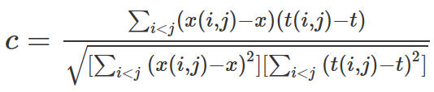
Machine Learning (Clustering effectiveness Cophenetic correlation)
Suppose that the original data {Xi} have been modeled using a cluster method to produce a dendrogram {Ti}
Define the following distance measures :
x(i,j)=|Xi−Xj| , the ordinary Euclidean distance between the i th and j th observations
t(i,j)= the dendrogrammatic distance between the model points Ti and Tj. This distance is the height of the node at which these two points are first joined together
Then, letting x be the average of the x(i,j) , and letting t be the average of the t(i,j),
Cophenetic correlation coefficient c is defined as
Values close to 1 is preferred
For comparison of distance methods, clustering techniques and Cophenetic, read
https://journalofinequalitiesandapplications.springeropen.com/track/pdf/10.1186/1029-242X-2013-203?site=journalofinequalitiesandapplications.springeropen.com

Slide 28
Machine Learning (Clustering effectiveness Silhouette coefficient)
Silhouette analysis can be used to study the separation distance between the resulting clusters.
The silhouette plot displays a measure of how close each point in one cluster is to points in the neighboring clusters and thus provides a way to assess parameters like number of clusters visually. This measure has a range of [-1, 1].
If the silhouette plot shows values close to one for each observation, the fit was good; if there are many observations closer to zero, it's an indication that the fit was not good.

Slide 29
Principal Component Analysis Concepts

Slide 30
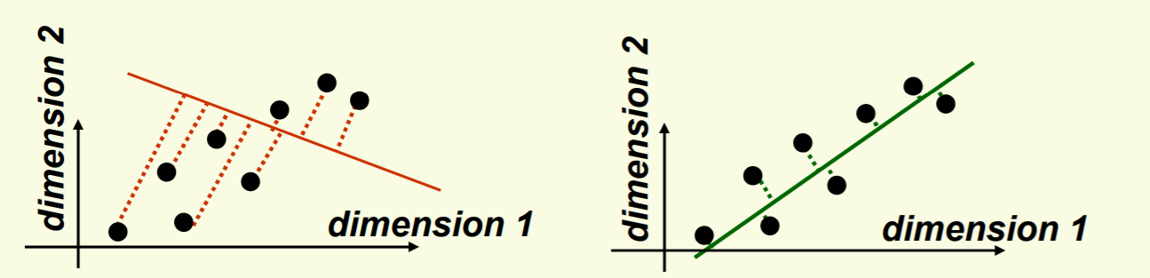
Principal Component Analysis
Main idea: seek most accurate data representation in a lower dimensional space
Example in 2-D, project data to 1-D subspace (a line) with minimal projection error
In both the pictures above, the data points (black dots) are projected to one line but the second line is closer to the actual points (less projection errors) than first one
Notice that the good line to use for projection lies in the direction of largest variance
Ref: http://www.cs.haifa.ac.il/~rita/uml_course/add_mat/PCA.pdf

Slide 31
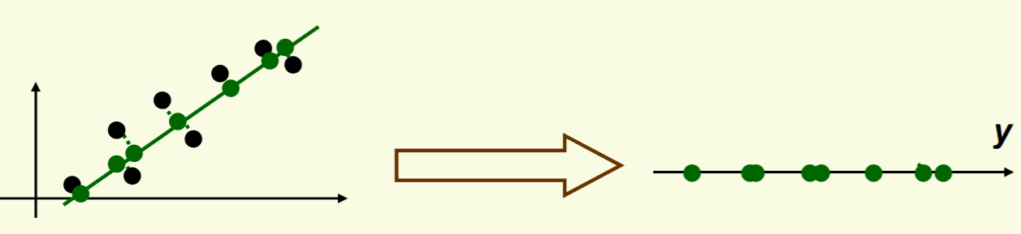
Principal Component Analysis
After the data is projected on the best line, need to transform the coordinate system to get 1D representation for vector y
Note that new data y has the same variance as old data x in the direction of the green line
PCA preserves largest variances in the data
Ref: http://www.cs.haifa.ac.il/~rita/uml_course/add_mat/PCA.pdf

Slide 32
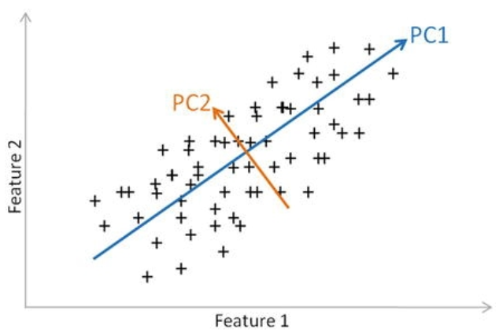
Principal Component Analysis
In general PCA on n dimensions will result in another set of new n dimensions. The one which captures maximum variance in the underlying data is the principal component 1, principal component 2 is orthogonal to it
Example in 2-D, project data to 1-D subspace (a line) with minimal projection error
Ref: http://www.cs.haifa.ac.il/~rita/uml_course/add_mat/PCA.pdf

Slide 33
Mechanics of Principal Component Analysis
http://setosa.io/ev/principal-component-analysis/

Slide 34
Principal Component Analysis steps
Begins by standardizing the data. Data on all the dimensions are subtracted from their means to shift the data points to the origin. i.e. the data is centered on the origins
Generate the covariance matrix / correlation matrix for all the dimensions
Perform eigen decomposition, that is, compute eigen vectors which are the principal components and the corresponding eigen values which are the magnitudes of variance captured
Sort the eigen pairs in descending order of eigen values and select he one with the largest value. This is the first principal component that covers the maximum information from the original data
Ref: http://www.cs.haifa.ac.il/~rita/uml_course/add_mat/PCA.pdf

Slide 35
Principal Component Analysis (Performance issues)
PCA effectiveness depends upon the scales of the attributes. If attributes have different scales, PCA will pick variable with highest variance rather than picking up attributes based on correlation
Changing scales of the variables can change the PCA
Interpreting PCA can become challenging due to presence of discrete data
Presence of skew in data with long thick tail can impact the effectiveness of the PCA (related to point 1)
PCA assumes linear relationship between attributes. It is ineffective when relationships are non linear

Slide 36
Principal Component Analysis steps
Lab-3 Principal Component Analysis on iris data set
Description – Explore the iris data set and perform PCA
The data set is winequality-red.csv
Sol: PCA-iris.ipynb

Slide 37
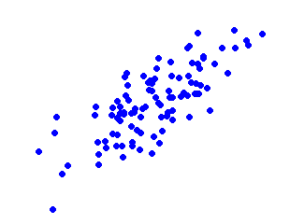
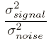
Principal Component Analysis (Signal to noise ratio)
Noise
Signal – all valid values for a variable (show between max and min values for x axis and y axis). Represents a valid data
Noise – The spread of data points across the best fit line. For a given value of x, there are multiple values of y (some on line and some around the line). This spread is due to random factors
Signal to Noise Ratio – Variance of signal / variance in noise.
Greater the SNR the better the model will be
Y max
Y min
X min
X max
Signal
X_std_df = pd.DataFrame(X_std)
axes = pd.plotting.scatter_matrix(X_std_df)
plt.tight_layout()

Slide 38
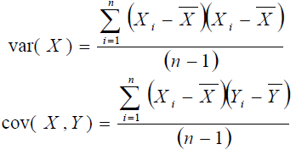
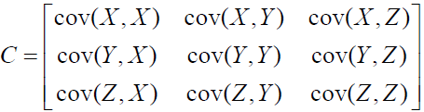
Principal Component Covariance Matrix
Variance is measured within the dimensions and co-variance is among the dimensions
Express total variance (variance and cross variance between dimensions as a matrix (variance matrix)
Covariance matrix is a mathematical representation of the total variance of individual dimension and across dimensions .
Covariance matrix for three dimensions x,y and z
eig_vals, eig_vecs = np.linalg.eig(cov_matrix)

Slide 39
Improving SNR through PCA ( Scaling the dimensions)
The mean is subtracted from all the points on both dimensions i.e. (xi – xbar) and (yi – ybar)
The dimensions are transformed using algebra into new set of dimensions
The transformation is a rotation of axes in mathematical space
2nd Principal Component
1 st Principal Component
X_std = StandardScaler().fit_transform(X)
eig_vals, eig_vecs = np.linalg.eig(cov_matrix)

Slide 40
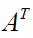
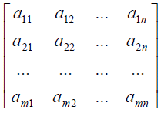
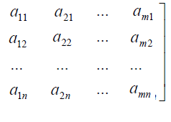
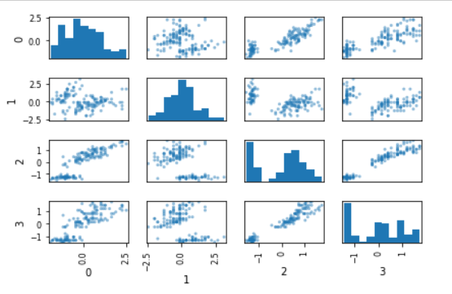
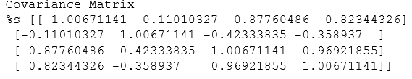
PCA (Calculating total variance (covariance and variance )
Multiplying the two matrices produces a matrix of total variance also called covariance matrix (a square and symmetric matrix).

Slide 41
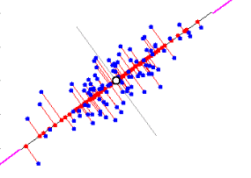
Improving SNR through PCA (Principal components)
The original data points are now represented by the red dots on new dimensions
It also introduces error of representation (vertical red lines from the blue dots to corresponding red dots on the new dimension)
The axis rotation is done such that the new dimension captures max variance in the data points and also reduces total error of representation
Noise
X min
X max
Signal
print('Eigen Vectors \n%s', eig_vecs)
print('\n Eigen Values \n%s', eig_vals)

Slide 42
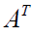
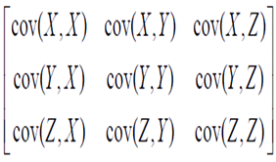
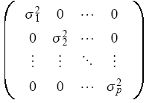
Properties of principal components and their covariance matrix
Thus to find principal components we need to get the diagonal matrix from the original covariance matrix
For this we have to transform the matrix A to a new matrix B such that the covariance matrix of B ( ), is a diagonal matrix (Ref to part 2, bullet 5)

Slide 43
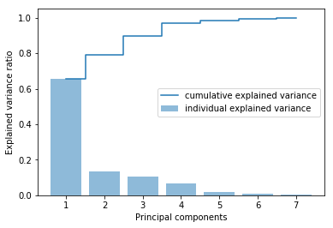
PCA for dimensionality reduction
PCA can also be used to reduce dimensions
Arrange all eigen vectors along with corresponding eigen values in descending order of eigen values
Plot a cumulative eigen_value graph as shown below
Eigen vectors with insignificant contribution to total eigen values can be removed from analysis (for e.g. eigen vector 6 and 7 below)

Slide 44
Thanks

